Slide 1
Dashboard Development using Power BI
A stepwise approach
Swati Kaware

Slide 2
Contents
Load Data
ETL process
Visualize data/Create Dashboard

Slide 3

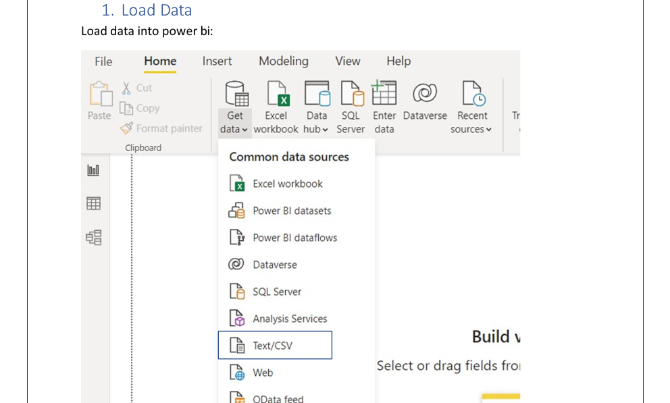

Slide 4
ETL process:
Cleaning the data in our case. Usually, ETL processes are performed by different teams. The structure defers from organization to organization.
We need to clean columns in data view of power bi for our better understanding of the data
user_rating rating_text
Zomato_user_rating
Id
We need to create new columns based existing column
book_url_present(based on pattern https://)
number_of_cuisines(using new col as)
number_of_cuisines = LEN('Eatery_TrainingData
LEN(SUBSTITUTE('Eatery_TrainingData - Copy'[cuisines],",",""))+1
- Copy'[cuisines])-
3. test col for calculation as Column
Column = IF('Eatery_TrainingData Copy'[number_of_cuisines]<6,'Eatery_TrainingData Copy'[number_of_cuisines])
-
-
4. segment_by_number_of_cuisines (to check how many number of cuisines are present in each row)
segment_by_number_of_cuisines = IF(ISBLANK('Eatery_TrainingData - Copy'[Column]), "6 or more",'Eatery_TrainingData - Copy'[Column])
5. user_rating_text_refined (to
create category as Average,Very
Good,Good,Poor,Excellent) by conditional column
Zomato_user_rating (groups) (to create group for rating values as 0-1.9,2-2.9,3-3.9,4- 4.9) by using Zomato_user_rating column

Slide 5
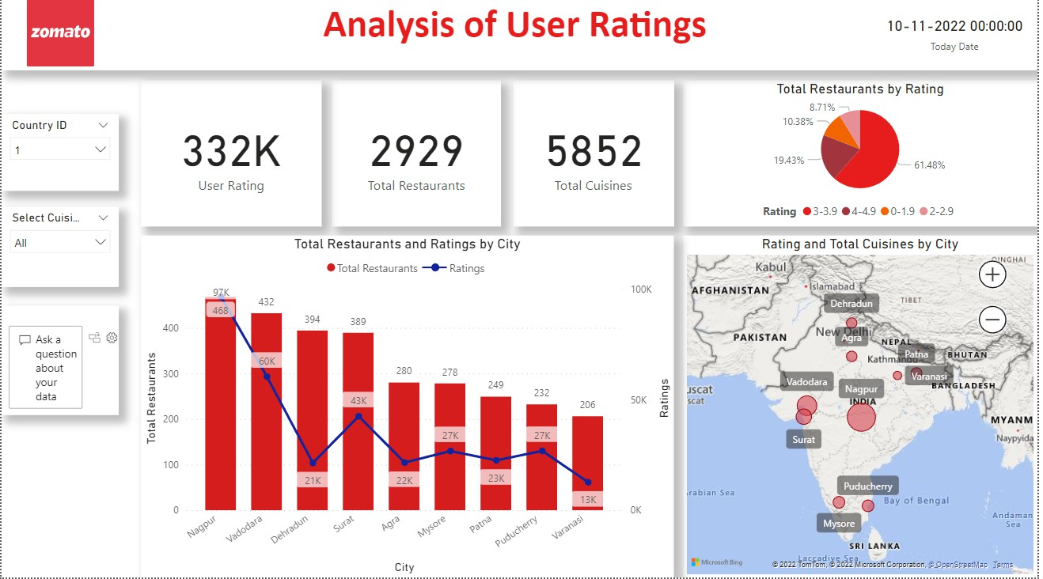
Visualize data/Create Dashboard:
KPIs
Total number of restaurants in INDIA(Country ID: 1)
Total number of cuisines
Total number of customer rating votes for restaurants
Charts
Pie chart: Total restaurants by user ratings
Bar chart: Total number of restaurants and user rating by city
Map chart: City by user_rating_votes and total cuisines

Slide 6
Thank You

